Slide 1
PacBio RS Workflow
Toby Ost / 14th November 2011
Notes:
In this module, I will discuss the end-to-end process for DNA sequencing with PacBio RS system.

Slide 2
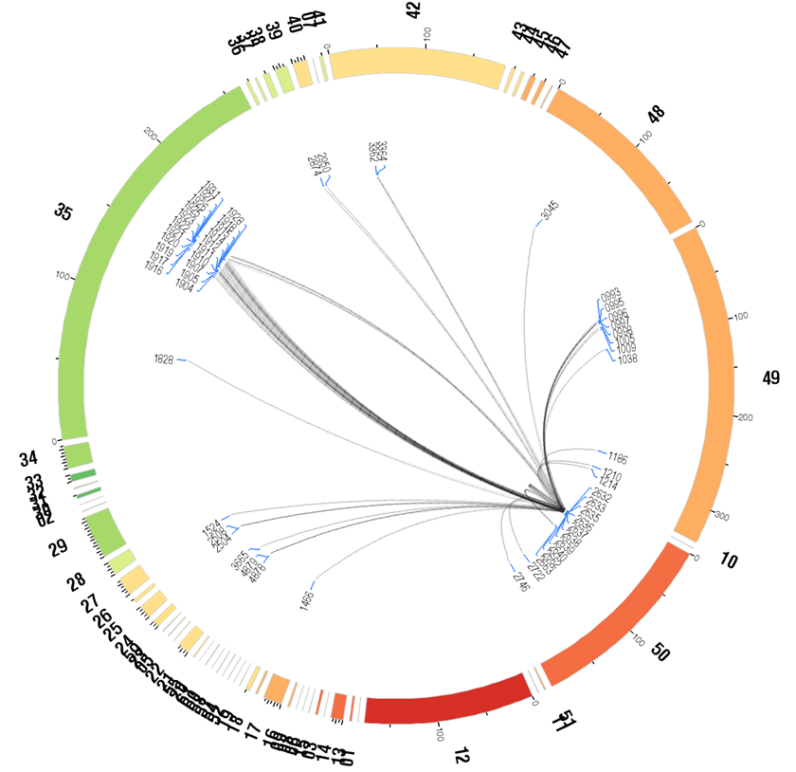
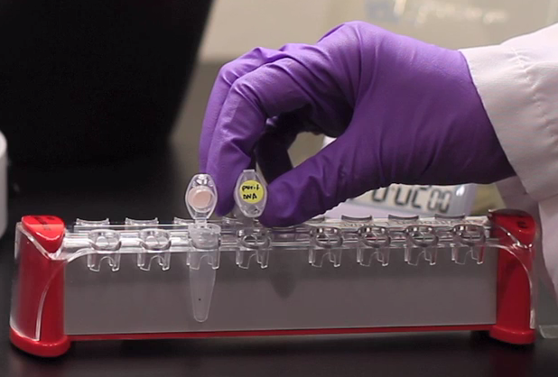
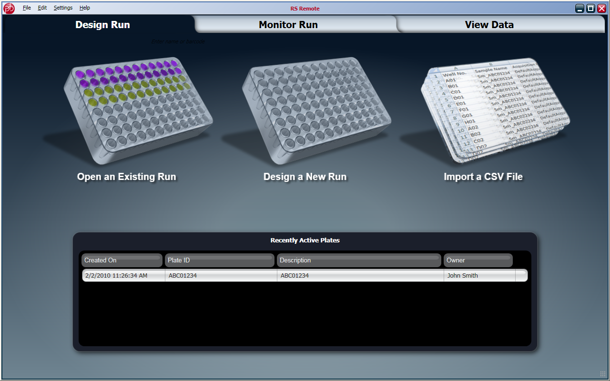
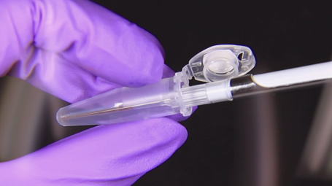
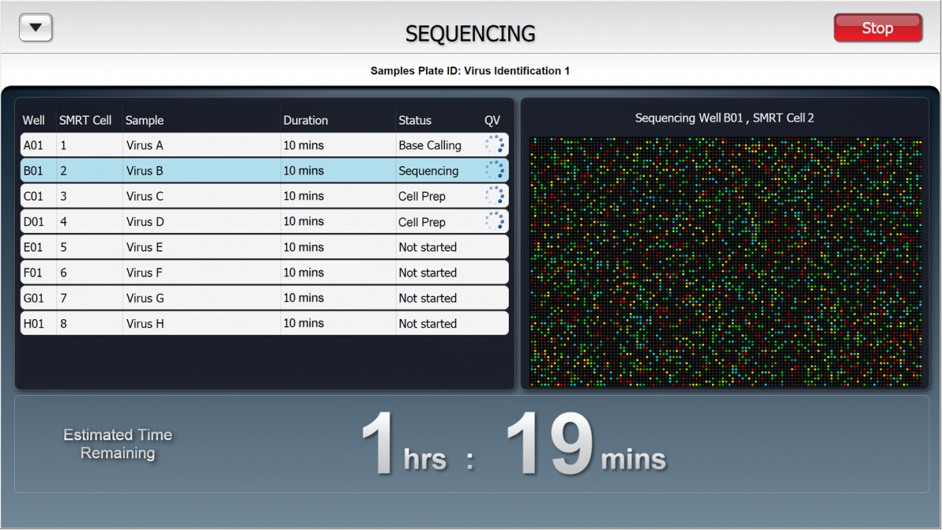
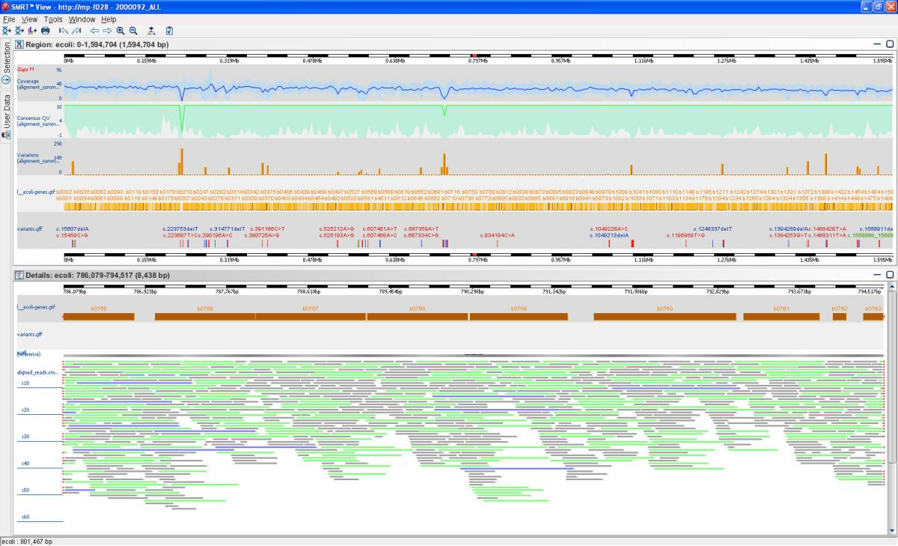
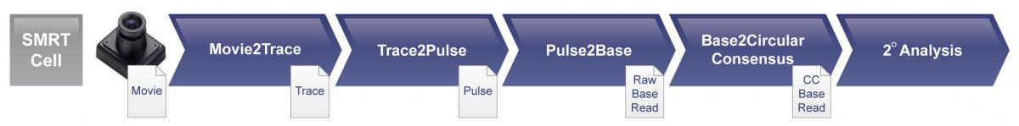
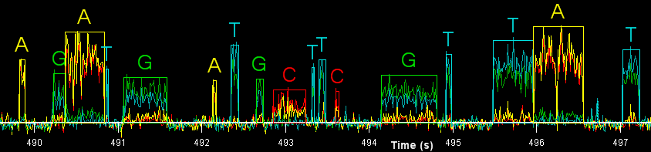
Sequencing Workflow
Template Preparation
Template Preparation
Run Design
Run Design
Polymerase Binding
Polymerase Binding
Instrument Run
Instrument Run
Primary Analysis
Primary Analysis
Secondary Analysis
Secondary Analysis
Tertiary Analysis
Tertiary Analysis
SMRT Portal & SMRT View
RS Touch
Blade center
RS Remote
Notes:
The workflow of DNA sequencing with PacBio RS can be explained in these seven steps.
First the DNA sample is prepared to create SMRTbell libraries.
A run design is then created on RS Remote software to define the sequencing run.
The polymerase is then bound to the SMRTbell Template using the binding calculator provided.
Next, the PacBio RS instrument is loaded with DNA samples, SMRT Cells, and sequencing reagents. The sequencing run can then be started from RS Touch user interface.
Primary Analysis is performed concurrently to the sequencing run, generating base calls. The readlength quality can be observed on RS Touch and RS Remote.
Once the sequencing is complete, secondary analysis jobs can be run from SMRT Portal and viewed from SMRT View stations.
The PacBio RS system is designed as an open platform to support tertiary analysis using common applications
In the following slides, I will discuss each of these steps in detail.

Slide 3
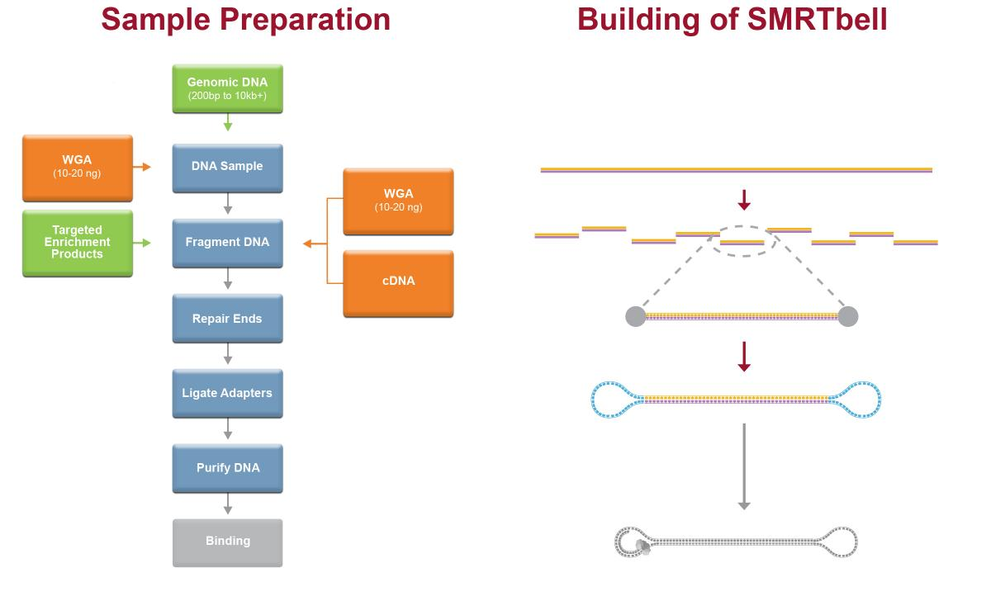
Template Preparation
DNA Sample
Fragment DNA
Repair Ends
Ligate adapters
Purify DNA
SMRTbell Template can be used to create libraries of varying insert lengths from 200bp to 10,000bp depending on the needs of the application.
Notes:
The PacBio sample preparation creates a structurally linear and topologically circular template. The SMRTbell Template can be used with a variety of sequencing protocols. A single streamlined protocol is used to create libraries of varying insert lengths from 200 bp to 10,000 bp depending on the needs of the application. There is no need for routine amplification and only 500 ng of sample is required for libraries of 1 kb or smaller. Suitable sample types include: purified genomic DNA, BACs, cDNA libraries, and PCR products. The SMRTbell libraries are stable, and may be stored for up to six months after preparation.

Slide 4
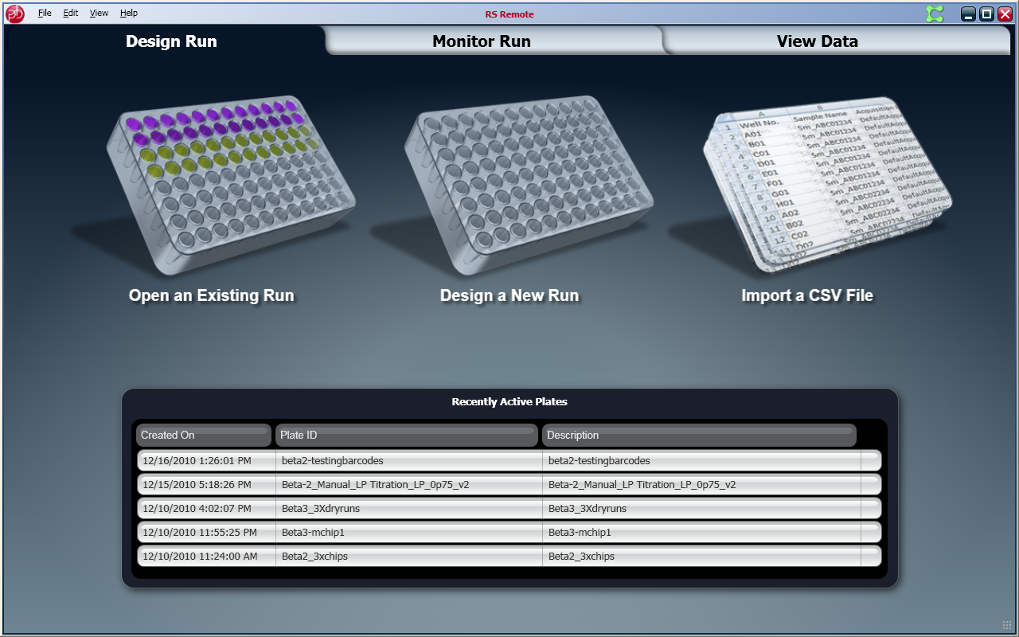
Run Design
Notes:
From RS Remote, you can design a sequencing run. The RS Remote is a Windows-based application that allows you to design and monitor sequencing runs as well as view primary analysis results, directly from your desktop.

Slide 5
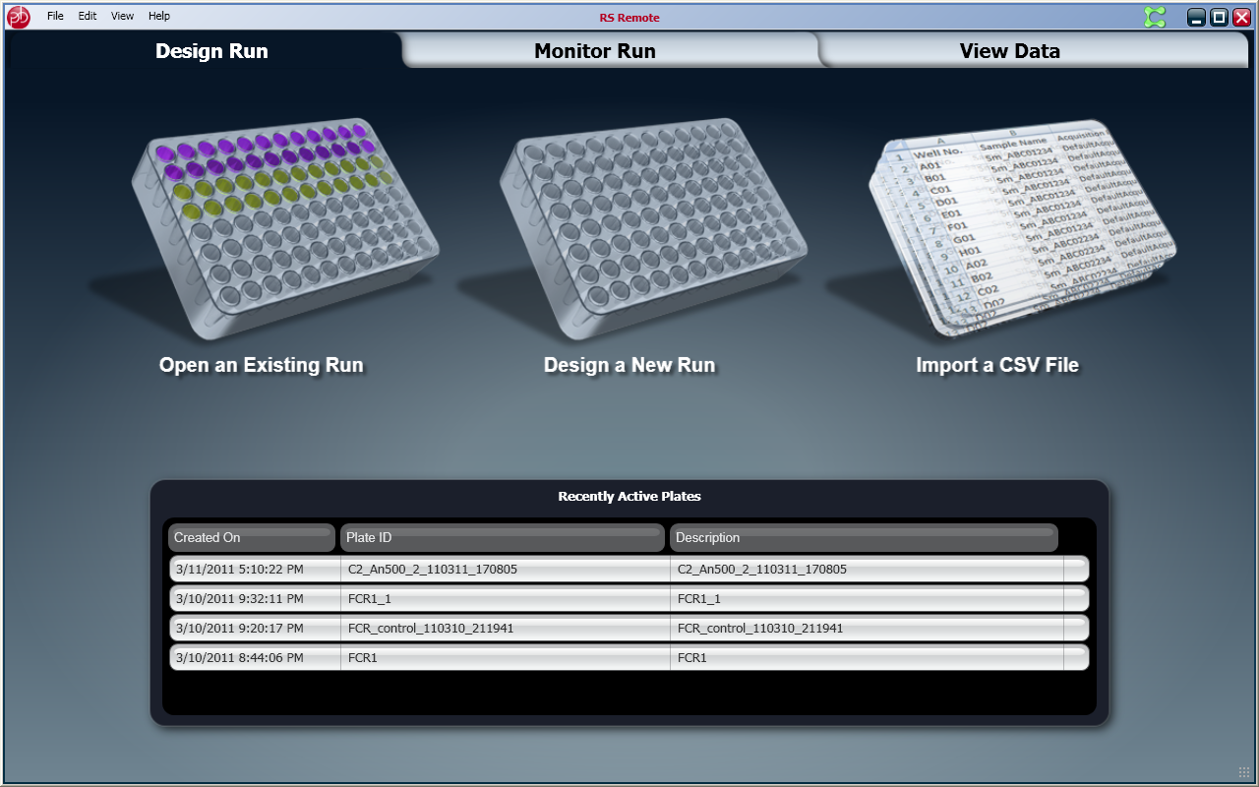
Designing a Run
Notes:
To design a new run, you need to select the number of wells in the sample plate. Then define the sample information, such as sample name, and barcodes for the kits used. After defining the content, you select the collection protocol settings, such as sequencing type, insert size, and number of cells per well. You can also setup parameters for secondary analysis for custom data management. After specifying the run parameters, you can save the sample sheet for the scheduled sequencing run on PacBio RS.

Slide 6
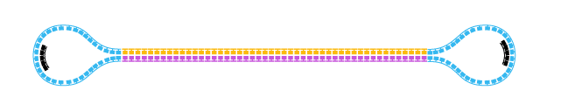
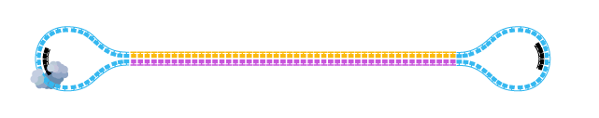
Polymerase Binding
PacBio DNA Template Polymerase Binding Kit
Binding Calculator available as Web based tool
Purify DNA
Anneal
Template
Bind Polymerase
Note:
Before you bind your polymerase to a template, you should have annealed
SMRTbell templates.
Notes:
Once samples are prepared, the next step would be to bind the SMRTbell library to the polymerase. A binding calculator is provided to assist you in determining the amount of binding reagent needed based upon the size of your annealed SMRTbell library. This incubation step requires less than 30 minutes of hands-on time and the DNA/Polymerase complex is stable for up to 3 days.

Slide 7
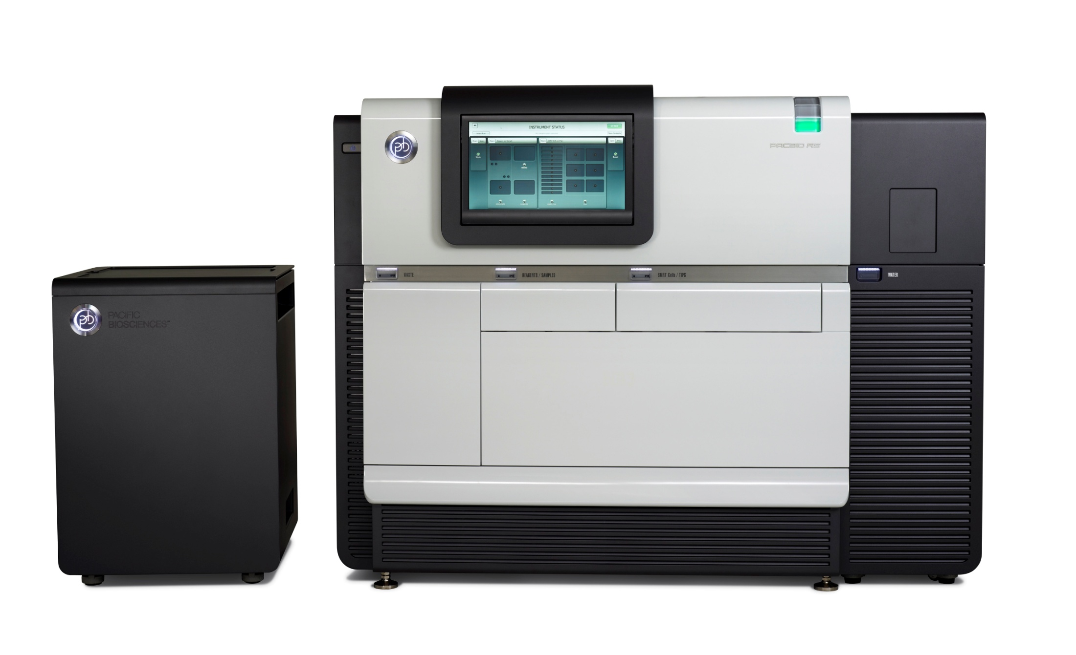
Instrument Run
RS Touch
Blade Center
Water
Reagents/Samples
SMRT Cell/ Tips
Waste
Notes:
The PacBio RS system conducts, monitors and analyzes single molecule, real-time (SMRT™) sequencing reactions. The instrument includes high performance optics, automated liquid handling, and on-board primary analysis. There are five primary user access points on the PacBio RS: The touchscreen interface, known as RS Touch, is the user's primary interaction point. It features an adjustable viewing angle, ample brightness for laboratory environments, and can be used with gloved hands. Throughout the sequencing process, the RS Touch provides feedback on the state of the PacBio RS, its contents, and your experiment. Just below the RS Touch are the two drawers. On the left is the Reagents/Samples Drawer, and on the right is the SMRT Cells/Tips drawer. The final two user access points are on either end of the instrument. On the right is the water supply compartment. On the left is the waste bin. Also included is the PacBio RS Blade Center. The blade center houses the instruments computational brain and handles instrument control and all primary analysis.

Slide 8
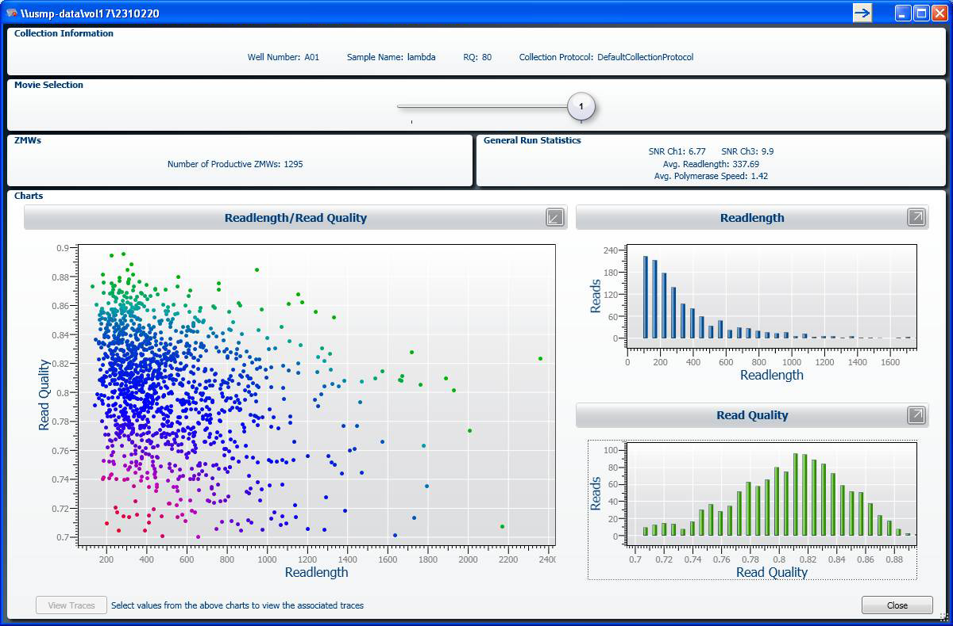
Primary Analysis
Notes:
As sequencing run progresses, real-time signal processing, base-calling and quality assessment are performed by the Blade Center. Through an optimized set of algorithms, the Blade Center translates the light pulses captured by the PacBio RS optics into basecalls and associated quality metrics. This data, along with metrics such as readlength distribution and polymerase speed are available for immediate review through the RS Remote and RS Touch interfaces. This primary data is simultaneously streamed to the secondary analysis system for further interpretation.

Slide 9
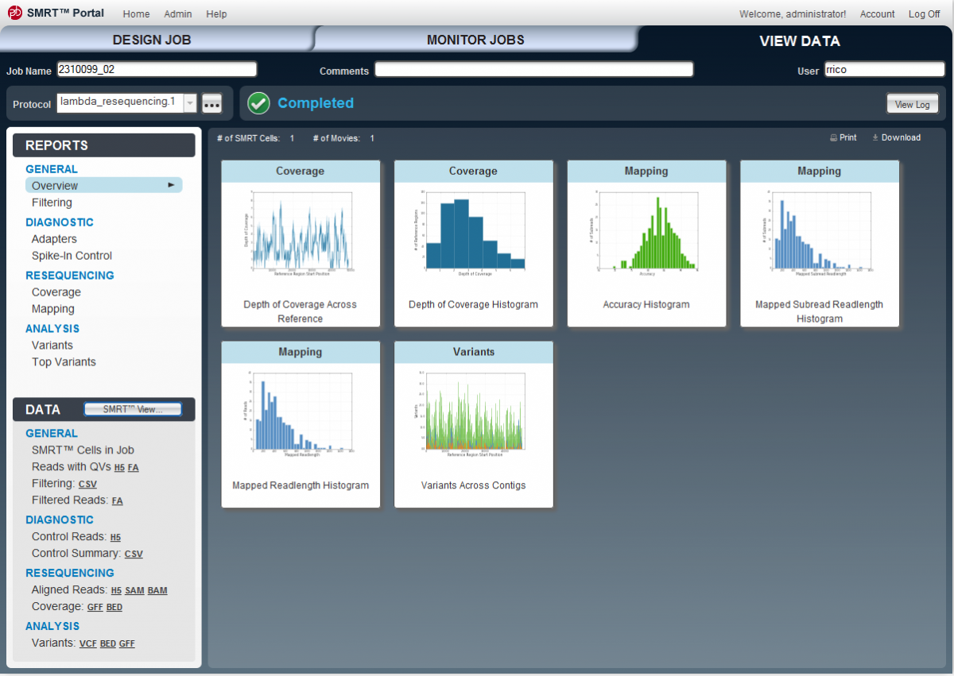
Secondary Analysis
Notes:
SMRT Portal is an open-source, browser-based application that allows the users to create, submit and monitor secondary analysis jobs. With SMRT Portal, you can align reads to a reference sequence or assemble reads into a de novo genome. It also allows for the creation and management of secondary analysis protocols and reference sequences. SMRT Portal produces experiment specific, data-rich reports in industry-standard formats containing both primary and secondary analysis data. Moreover, all data files are accessible directly through SMRT Portal, allowing for third party analysis.

Slide 10
View Reports: SMRT View
Notes:
SMRT View is a scalable and extensible framework for graphical data exploration that allows you to visualize and interact with secondary analysis sequencing data. Graphical representations of variants, quality values, and other metrics along with rich annotations provide you with a broad range of ways to analyze the data.

Slide 11
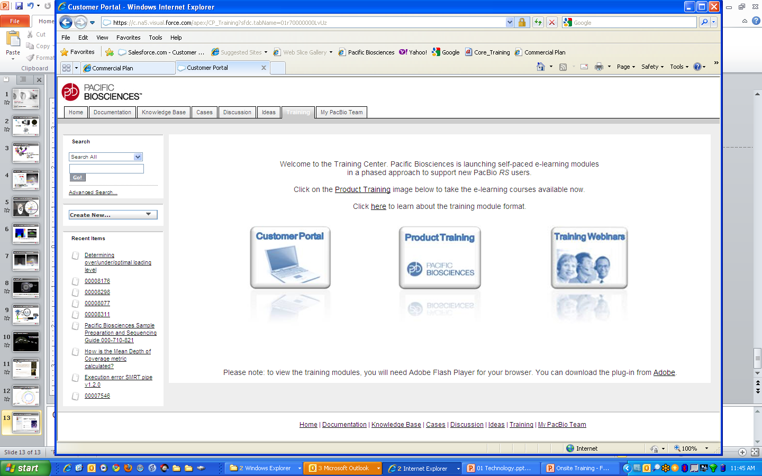
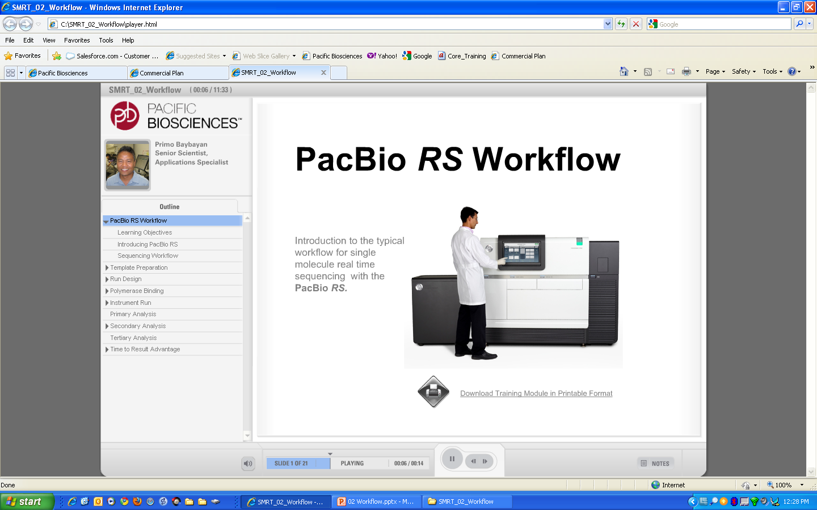
eLearning Module on SMRT Technology on PacBio Portal
Notes:
An overview of PacBio RS workflow is available as self-paced eLearning module from the PacBio Customer Portal. Login to the PacBio Portal and go to the Training Tab. Click on the Product Training icon and select PacBio RS Workflow icon to launch the eLearning module.

